Slide 1
Heart Disease Prediction

Slide 2
Table of contents
01
02
03
04
05
06
The disease and its symptoms
Importance of early prediction
EDA
Data preprocessing and cleaning
Model and Accuracy Test
Result

Slide 3

Introduction to the Heart disease

Slide 4

Importance of Early Prediction

Slide 5
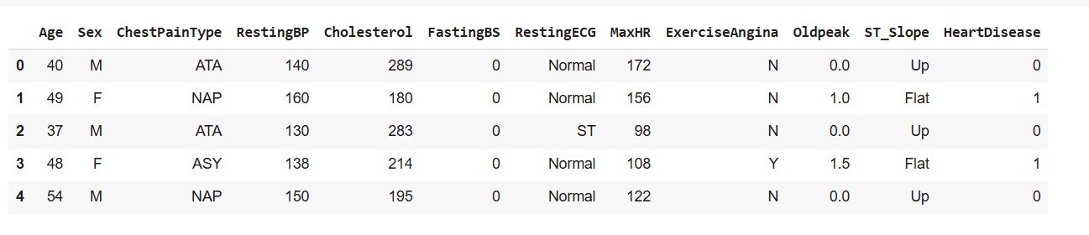
Data-Set
df.head()

Slide 6
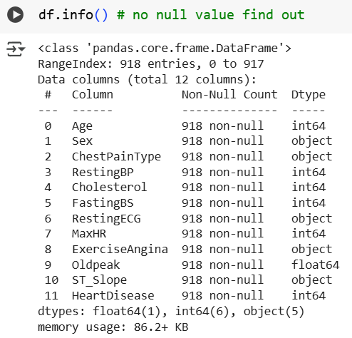
Exploratory Data Analysis (EDA)

Slide 7
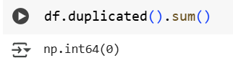
Exploratory Data Analysis (EDA)

Slide 8
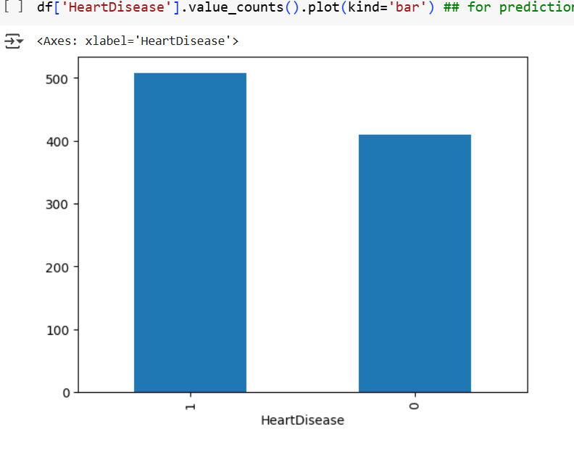
Exploratory Data Analysis (EDA)

Slide 9
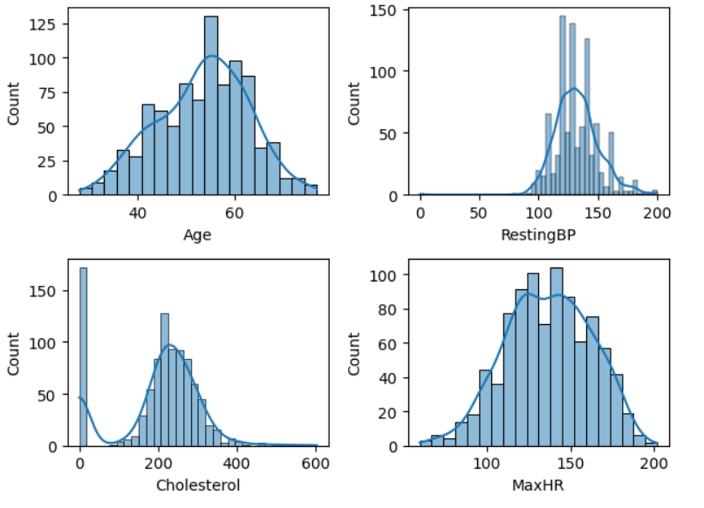
Exploratory Data Analysis (EDA)

Slide 10
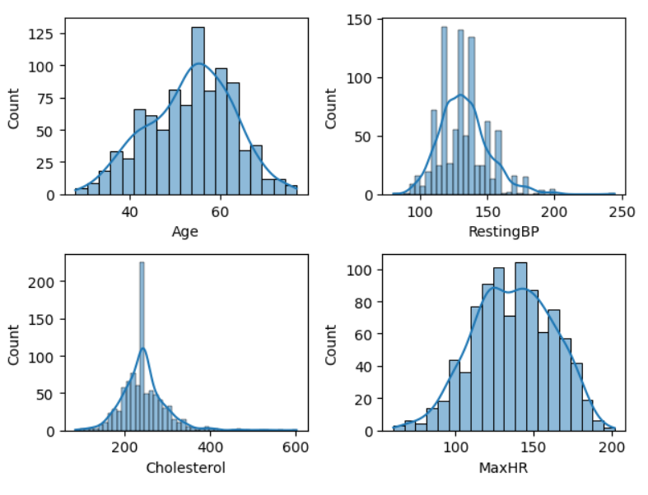
Exploratory Data Analysis (EDA)

Slide 11
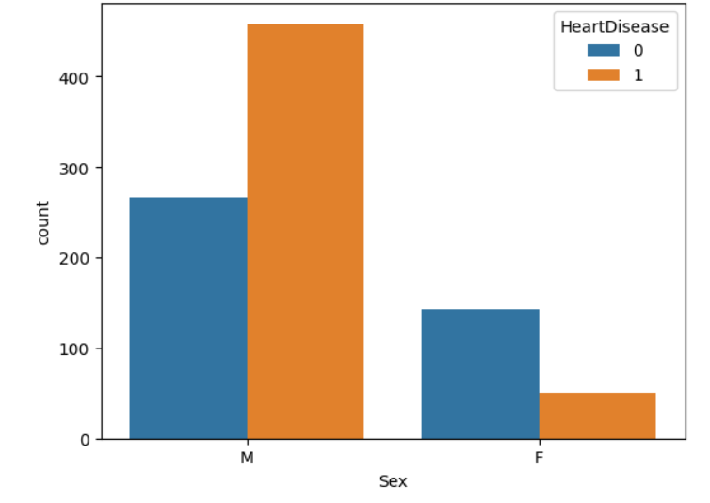
Exploratory Data Analysis (EDA)

Slide 12
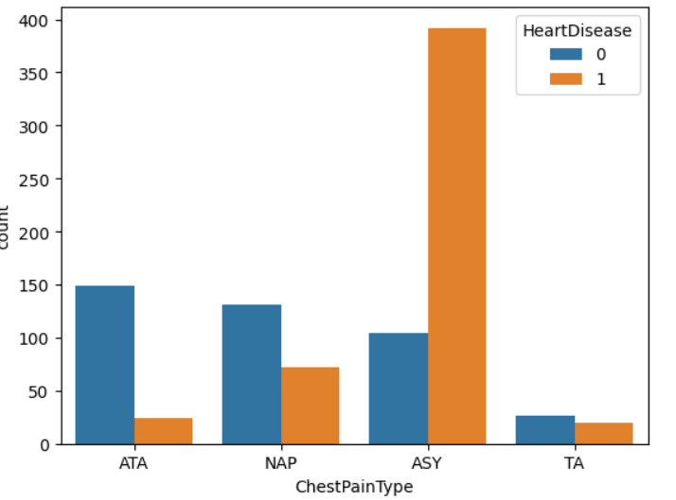
Exploratory Data Analysis (EDA)

Slide 13
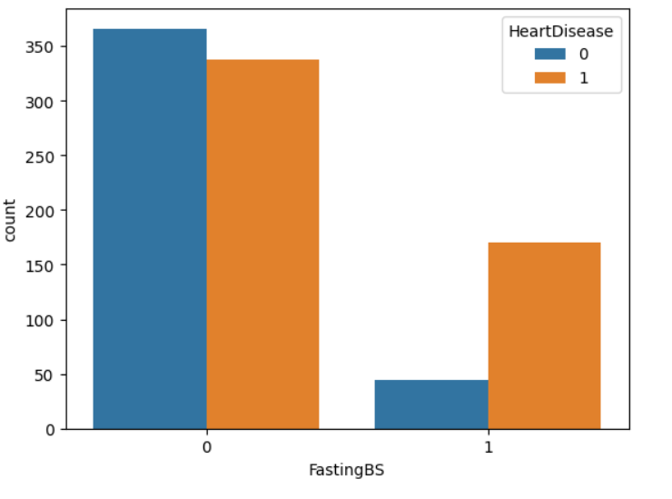
Exploratory Data Analysis (EDA)

Slide 14
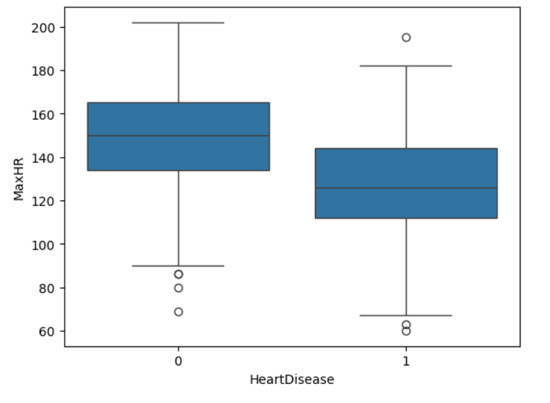
Exploratory Data Analysis (EDA)

Slide 15
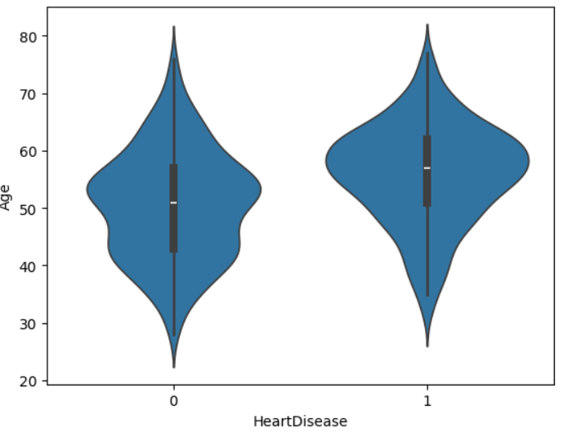
Exploratory Data Analysis (EDA)

Slide 16
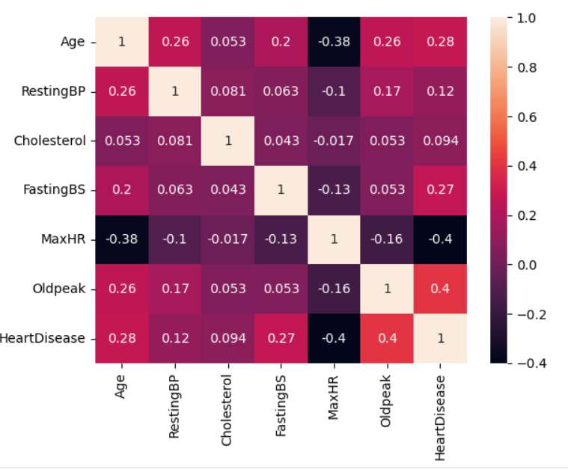
Exploratory Data Analysis (EDA)

Slide 17
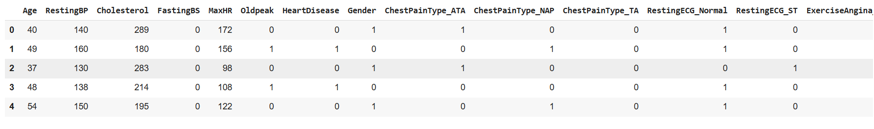
Data preprocessing and cleaning
df_encode = pd.get_dummies(df,drop_first=True)
df_encode = df_encode.astype(int)

Slide 18
Data preprocessing and cleaning
x= df_encode.drop('HeartDisease',axis=1)
y= df_encode['HeartDisease']
x_train,x_test,y_train,y_test = train_test_split(x,y,test_size=0.2,random_state=42)

Slide 19
Data preprocessing and cleaning
scaler = StandardScaler()
x_train_scaled = scaler.fit_transform(x_train)
x_test_scaled = scaler.transform(x_test)

Slide 20
Model Test
models= {
'LogisticRegression': LogisticRegression(),
'DecisionTreeClassifier': DecisionTreeClassifier(),
'RandomForestClassifier': RandomForestClassifier(),
'KNeighborsClassifier': KNeighborsClassifier(),
'GaussianNB': GaussianNB(),
'SVC': SVC()
}

Slide 21
Model Test
for name,model in models.items():
model.fit(x_train_scaled,y_train)
y_pred = model.predict(x_test_scaled)
acc = accuracy_score(y_test,y_pred)
f1_result = f1_score(y_test,y_pred)
result.append({
'model':name,
'accuracy':round(acc,4),
'f1_score': round(f1_result,4)
})

Slide 22
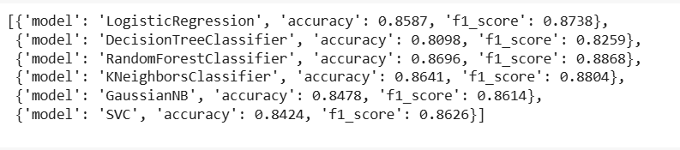
Model Test

Slide 23
Pick Model High Accuracey
import joblib
joblib.dump(models['RandomForestClassifier'],'RFC_heart.pkl')
joblib.dump(scaler,'scaler.pkl')
joblib.dump(x.columns.tolist(),'col.pkl')

Slide 24
Real Data For Test Case
Age | RestingBP | Cholesterol | FastingBS | MaxHR | Old peak | Gender | ChestPainType_ATA | ChestPainType_NAP | ChestPainType_TA | RestingECG_Normal | RestingECG_ST | ExerciseAngina_Y | ST_Slope_Flat | ST_Slope_Up | Heart Disease
45 | 135 | 190 | 0 | 170 | 0.0 | F | 1 | 0 | 0 | 1 | 0 | 0 | 0 | 1 | 0
65 | 155 | 245 | 1 | 120 | 2.5 | M | 0 | 0 | 1 | 0 | 1 | 1 | 0 | 0 | 1
50 | 120 | 180 | 0 | 160 | 0.0 | M | 0 | 1 | 0 | 1 | 0 | 0 | 0 | 1 | 0
57 | 145 | 230 | 0 | 132 | 1.2 | F | 1 | 0 | 0 | 1 | 0 | 0 | 1 | 0 | 1

Slide 25


Slide 26
900+
87%
88%
RFC
Patients treated
Success rate
f1_score

